Slide 1
Industry Business- AOCI
Mass Software Upgrade (MSU)
OPEN Approval
PSC date : 08- Aug -2014

Slide 2
Agenda
  Project presentation
    Project objectives
    Project description
    Main activities and deliverables until DO
    Planning
    Effort and cost
    Organization
    Risks
PSC expected decisions
  PSC OPEN decision
  SELECT Stage Gate decision in PSC or Core team
Notes:
The project Name, the project manager Name, the Chorus/SAP IDs and the project status are mentioned in the model.
So please select the mask in order to put the data. This will allow automatic replication on all slides.
This first slide is dedicated to the different topics of the agenda, and to the decision expected from the PSC.
The decisions consist in
Main milestone Go / No Go decision
Issues (schedule, resources, cost, feature, etc …) when not in the limit of the delegation.
Decision requiring staff level
The project manager prepares the decision so that the PSC can make it during the meeting, or commit on a date to make it.

Slide 3
Project objectives
  Purpose and origin
    Maintenance in a typical solar power plant is allowed 8-10 hours (non-operating hours in the day when there is no sunlight).
    Conventional methods (FTP) of upgrading a device takes approximately 5 minutes to upgrade on device. Example: For 7000 devices it will take 24 days to upgrade all devices.
    Minimize the turn around time to upgrade devices at solar power plant with better and efficient way of upgrading devices at solar power plats.
  UVP
    MSU can perform simultaneous file transfer to may devices on the network
    Bandwidth consumption will always be equal to 1 device
    Time consumption will always be equal to 1 device
    Apply upgrade process on selected group (s)of devices

Slide 4
Project description
  Main features
    MSU can perform simultaneous file transfer to may devices on the network
    Bandwidth consumption will always be equal to 1 device
    Time consumption will always be equal to 1 device
    MSU creates list of the devices on the network before to start the process
    Apply upgrade process on selected group (s)of devices
    Multiple groups can be selected simultaneously (different Binaries)
    Status of file transfer is validated by CRC at the end of file transfer (Optional can be enable/disable by compile time MACRO)
  Offer description
    MSU is a protocol with Client- Server Model based on UDP/IP protocol
    MSU Server : UI based application (developed in .NET) which facilitates user to select devices to be upgrades with selected files (Binary/Executable)
  `MSU Client : Developed in C language and part of Device firmware , also available as C library.
  Connected products, projects or programs
  None

Slide 5
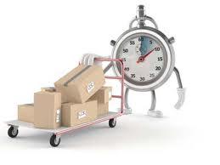
Main activities and deliverables until DO
Activities | Deliverables
Project Initiation | Open PSC Presentation
Requirement Gathering | Requirement Document
Architecture & Design | Architecture & Design Document
Project Planning | Project Management Plan along with all subsidiary plans

Slide 6
Planning
28-Jul-14
14-Aug-14
12-Sep-14
27-Feb-15
Open
Select
Do
Implement
Produce
Sell
Close
Concept & Feasibility
Definition
Product & Process Design
Implementation & Validation
Product for Stock
Launch & Closure
Release for Validation
Legend:
GO/No GO Stage Gate
Phase

Slide 7
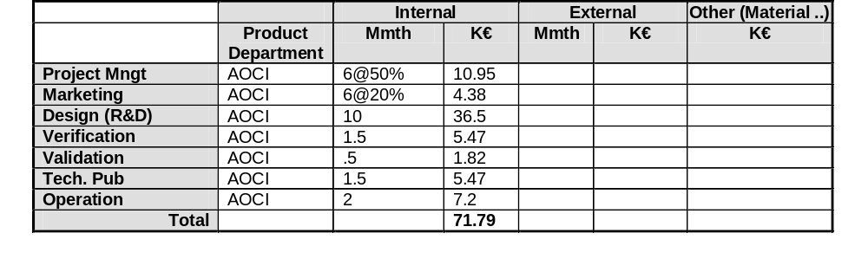
Effort and cost

Slide 8
Organization
  Core Team
Elakiyakumar
(Domain Manager)
Arun Dhakshina
(Offer Marketing Leader)
Dhirendr Pratap Singh
(Project Manager)
Pawan Modi
(Architect/Tech Lead)
Amulya Shekhar
(Developer)
Urvashi Gautam
(Associate Lead)
Senthil Nathan
(Developer)
Chetan M
(Associate Lead)
Legend:
Communication
Reporting

Slide 9


Risk situation (3 main risks)
Project Manager & Team Feeling:
Notes:
Present the current risk estimation and changes.
Prepare expected decisions from the PSC. Present a synthesis for decision making, and don't spend too much time on details. When needed, bring additional slides for a back up presentation in case of questions from the PSC.
Present the expected results for the next month.

Slide 10

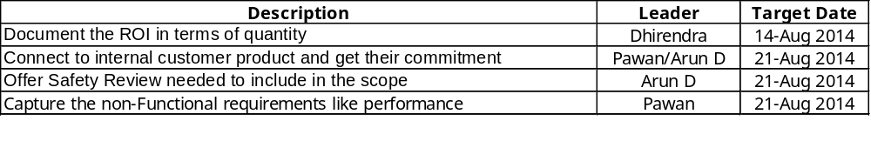
GO without restriction
GO with restriction
✓
No GO
Decision Perimeter / Comment
Restrictions (will be copied and followed in SysCo PSC action plan)
Notes:
Focus on main events such as milestones, versions, etc …
Report on decisions made by the CDT in the scope of the delegation, which have an impact on the commitments and may influence the other projects.
Always refer to what was planned for the month in reference with the previous PPR.
Present the current risk estimation and changes
Prepare expected decisions from the PSC. Present a synthesis for decision making, and don't spend too much time on details. When needed, bring additional slides for a back up presentation in case of questions from the PSC.
Present the expected results for the next month

